Slide 1
Project Overview presentation on All Day Assist
Presented
by:
-> Ankit Kumar Singh(1811981053)
-> Ashish Kumar Chourasiya (1811981387)
-> Shivam Thakur(1811981292)
-> Rahul Rana(1811981242)
Under the supervision
of
(Mr.Girish Rao)
( Department of Computer Science and Engineering )

Slide 2
Introduction
“All-Day-Assist” is an attempt to provide various tools packed-together at a single platform that will surely help the user on daily basis to get done with different tasks that he/she may have during the day.

Slide 3
Problem statement
Don’t you feel annoyed when you have to open or toggle between different apps to access different functionalities that you require on a daily basis?
Don’t you want all of these functionalities at a single platform?
IF YES,
Well, that’s exactly what All-Day-Assist does. It provides you with variety of features at a single platform, so that you don’t have to get into the hassle of switching between different apps.

Slide 4
Real-LIFE Applicability
If a person don’t want to have different applications in his/her system but still want to have access to their features can get the
“All-Day-Assist” where he/she can have access to a variety of features at one Application.
This can save so much time , memory space and lots of efforts of the Individual.

Slide 5
Features Provided :
1. Expense tracker:- The user can have a track of their cash flow, expenses and keep a history of their whole monthly budget. This will help them take smart financial steps in future .
2. Weather app :- The user will have access to the information about the weather conditions at his/her location . This will help them to make the plans for the day more
effectively.
Magic Notes/To-do list :- The user can write important -stuff in the Magic-notes
OR he/she can use it as a to –do list to structure the day efficiently and boost productivity.
4. FUN-ZONE :- This will give the user access to play games, if he/she needs to take a little break from the work they are doing or if they need to de-stress themselves.

Slide 6
Technology stack Used
1. HTML
2. CSS
3 Bootstrap
4 JAVASCRIPT

Slide 7
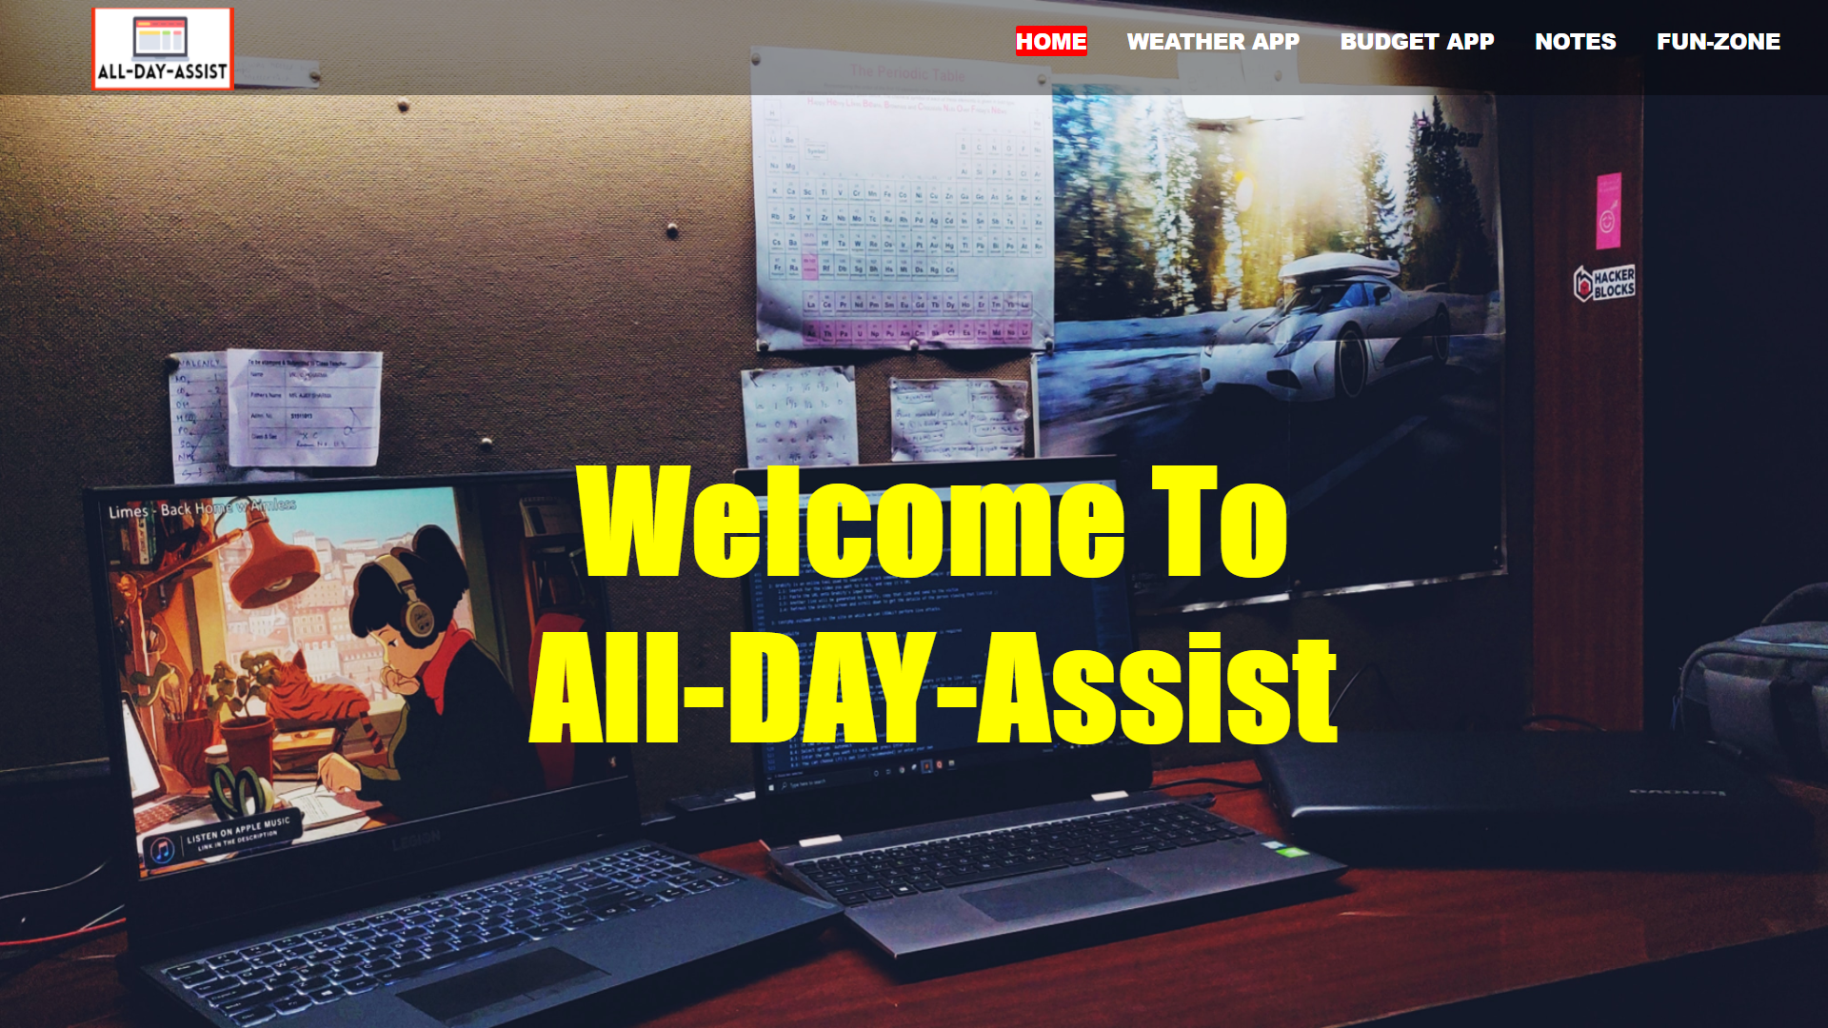
SCREEN SHOTS OF THE PROJECT

Slide 8
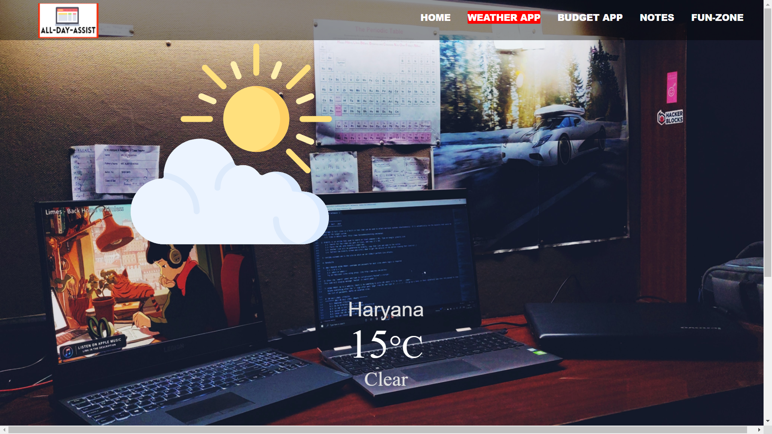
WEATHER APP

Slide 9
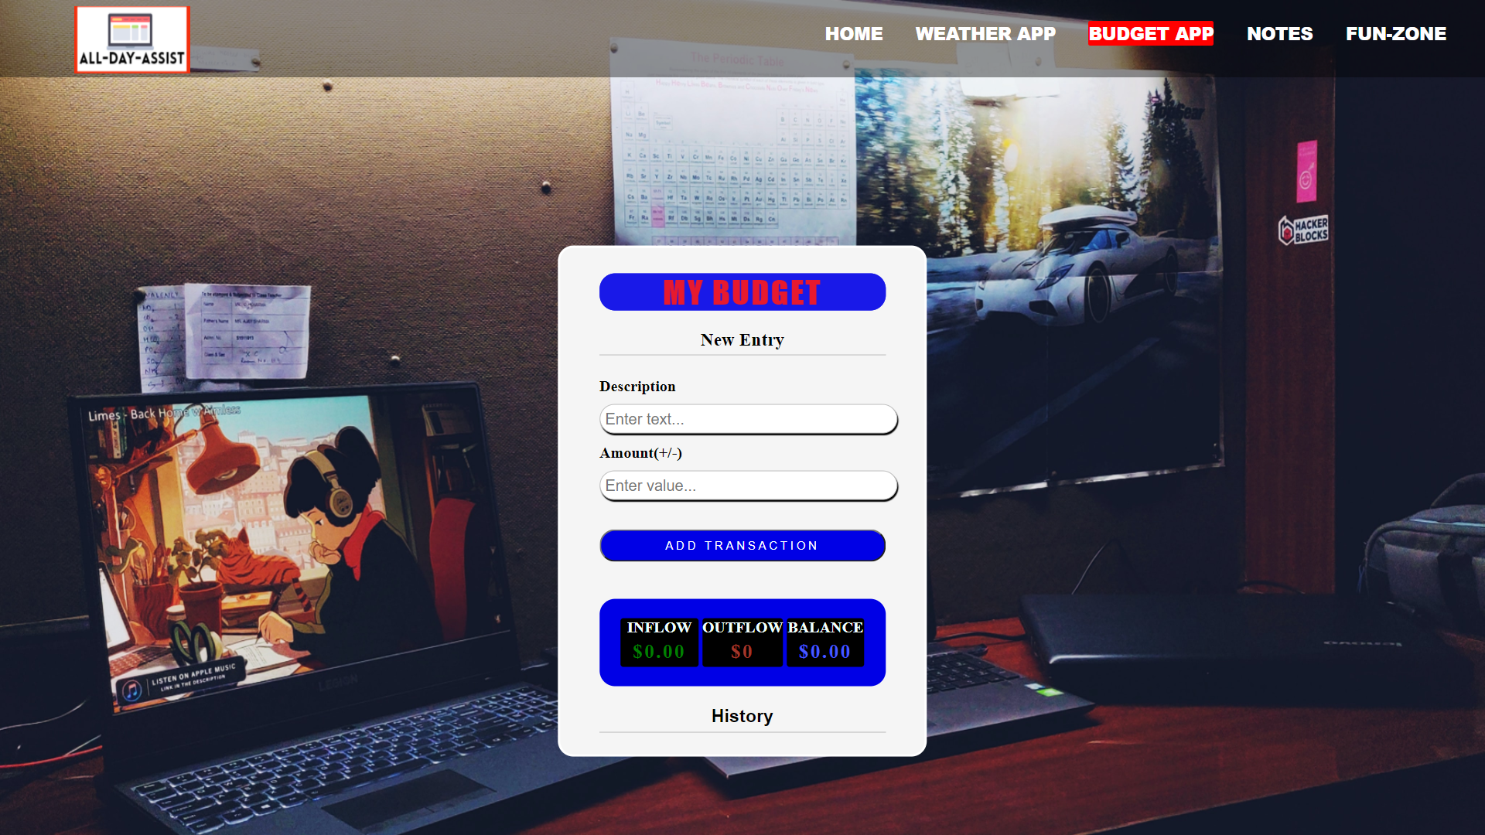
BUDGET APP

Slide 10
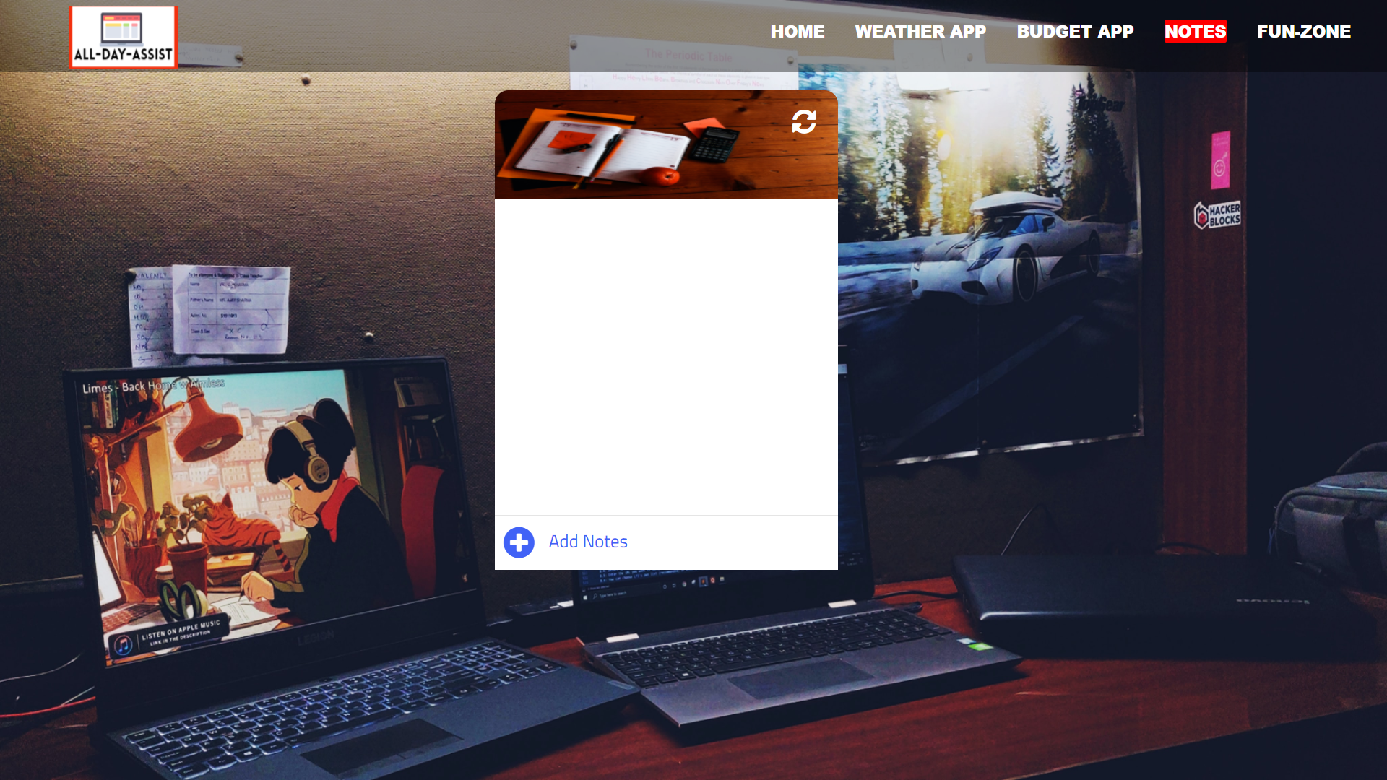
To-do List / Notes

Slide 11
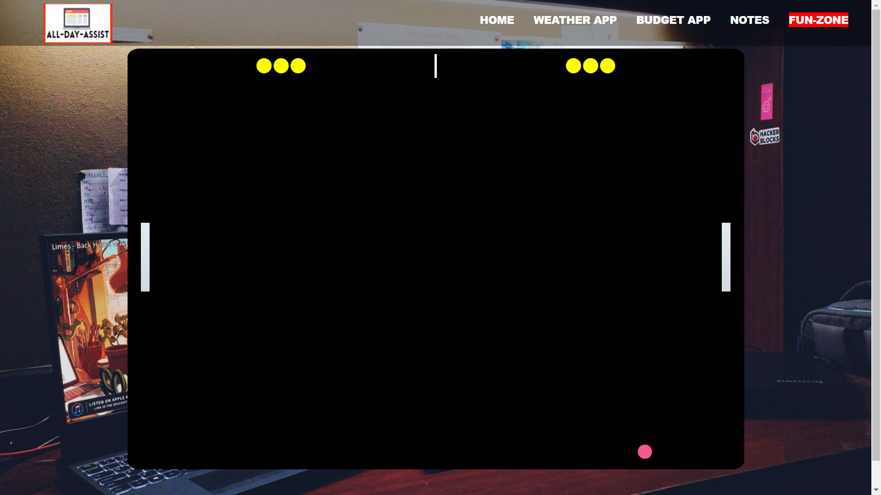
FUN-ZONE

Slide 12
Description of the contribution
Weather app :- Ankit Singh
Magic notes/To-DO list : Shivam Thakur
Expense Tracker : Rahul Rana
Fun-Zone : Ashish Kumar Chourasiya

Slide 13
THANK YOU ☺

